Slide 1
School of Nursing
Accreditation and Quality Assurance Center Visit
Sunday, 4th of March, 2018

Slide 2
Outline
Overview about School of Nursing
Facts and Figures
School achievements
Follow up/ the last visit
Challenges

Slide 3
Overview
Three administrative Departments
Three Academic Programs:
BSc. In Nursing
Master (Three tracks; Critical, Palliative and Psychiatric Mental Health)
PhD

Slide 4
Number of Faculty and Staff 2016-2019

Slide 5
Faculty and Staff 2017-2018

Slide 6
Faculty According to the Rank, 2017-2018

Slide 7
Faculty and Staff by Gender 2017-2018

Slide 8
إحصائية بأعداد الطلبة المقبولين - الفصل الأول 2018/2017

Slide 9
عدد الطلبة في برنامج البكالوريوس

Slide 10
The Current Number of Graduate Students

Slide 11
Total Number of Students, 2017-2018

Slide 12
School Achievements
International Accreditation ACEN
International Collaboration
Health Culture (Elective Course)
Youth Friendly Clinic

Slide 13
School Achievements
Interactive Learning
E learning:
Most of the School courses are delivered through E learning
More than 70% of faculty are using E-Learning
Induction Program (New Faculty and Staff)
Orientation program
Evaluation of the program

Slide 14
School Achievements
Faculty and Staff Development Committee
7 workshops (one for administrative staff)
3 out of 7 were conducted by SON Faculty
2 out of 7 (Fulbright)
2 out of 7 (Local community)
Journal Club/ Monthly

Slide 15
School Achievements
Accreditation and Quality Control Committee
Socail Committee
Regular Dean´s Meeting with:
Faculty and Staff
Administrative Staff

Slide 16
SON Students
Regular Dean and administrative committee meeting/Cohort
Representative in SON Standing committee
Suggestion box
Incident Report
Graduate Follow up Committee

Slide 17
Graduate Follow Up Committee
Undergraduate program completion rate for the past 3 years by cohort
Cohort | Program completion rate
2011-2015 | 80.5%
2012-2016 | 83.1%
2013-2017 | 95.2%

Slide 18
Graduate Follow Up Committee
Placement rate of the year 2016-2017 by Program option
​Academic year | Program Option
2016-2017 | Regular | Bridging
 | 86.02% | 100%
​ Placement rate of the year 2016-2017 was 88.57%

Slide 19
متابعة الملاحظات الواردة في تقرير زيارة المركز
4/2017

Slide 20
بند رقم 2
دراسة اراء اصحاب المصلحة في البرامج
Advisory Committee
Employer Survey

Slide 21
Results of Employer Survey 2016-2017
Items | Very unsatisfied n (%) | Unsatisfied n (%) | Satisfied n (%) | Very Satisfied n (%)
Over all, how satisfied are you with BSC nursing program at the university of Jordan? | 3 (4.8) | 15 (24.2) | 30 (48.4) | 9 (14.5)

Slide 22
بند رقم 3
توفر نتاجات تعلم معتمدة من لجنة التعلم في الجامعة لكل برنامج اكاديمي

Slide 23
بند رقم 4
توافق اساليب التعلم والتعليم وأساليب التقييم مع نتاجات تعلم البرامج والمواد الدراسية

Slide 24
Course Isuues
Unified course syllabi (instrctions and regulations)
Course assessment (theory and clinical)
Course report
Interactive learning

Slide 25
Clinical courses
Clinical exam (in the clinical area/ committee)
Instructions for clinical training (student, faculty and staff)
Student evaluation:
Clinical instructor
Clinical course
Clinical area

Slide 26
Procedure Manual (Nursing Procedures)

Slide 27
نتائج تقييم المواد العملية Course Assessment 1st Semester, 2017-2018

Slide 28
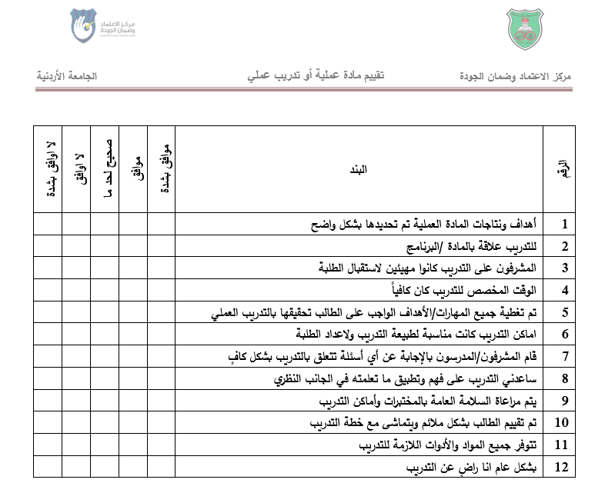

Slide 29
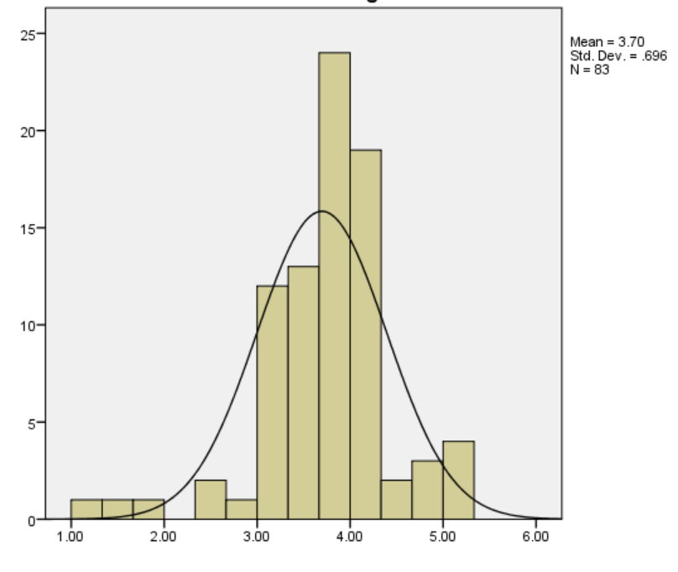
Items Mean Scores Per Student
Example 1: Adult Health Nursing Course-Clinical

Slide 30
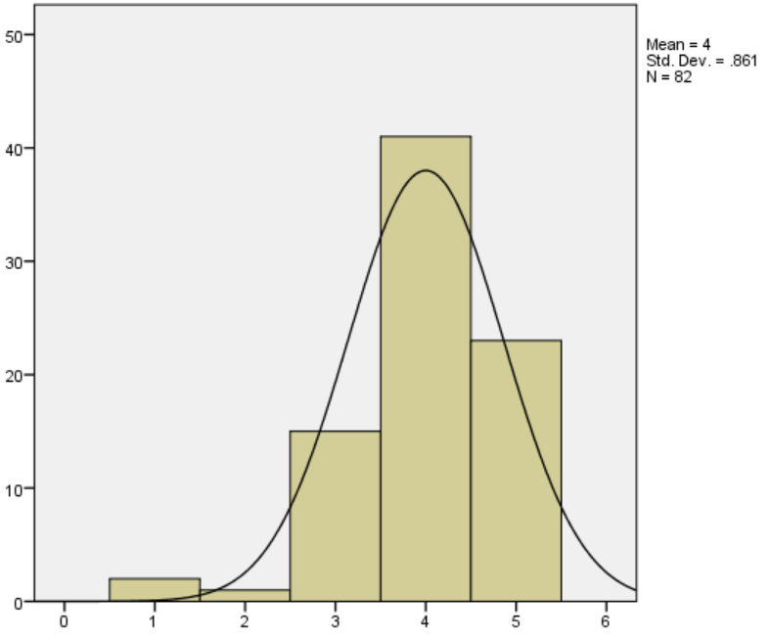
Highest Mean Score (out of 5): Q2: للتدريب علاقة بالمادة /البرنامج

Slide 31
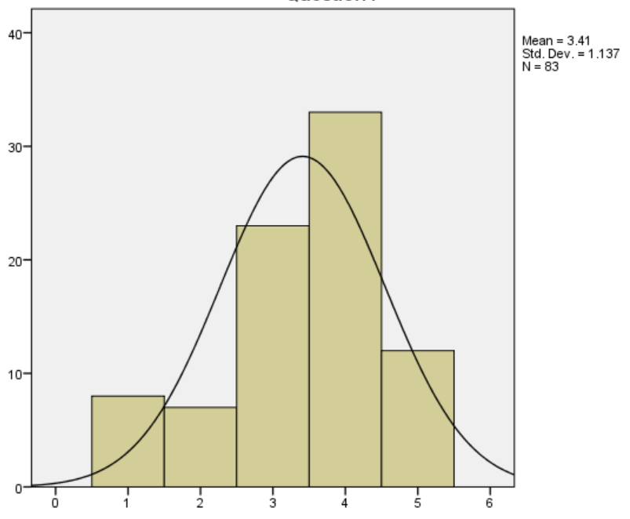
Lowest Mean Score: Q4: الوقت المخصص للتدريب كان كافياً

Slide 32
Exam Issues
Exam template (QF-SON-04.01)
Exam instructions:
Students (before and during the exam)
Course cordinator
Senior invegilator
Invegilator

Slide 33
Exam Issues
Exam Peer review Form (QF-SON-04.02)
Exam Envelop Form (QF-SON-04.03)
Exam Evaluation Form (QF-SON-04.04)

Slide 34
Exam Issues
Exam Incident Report (QF-SON-02.03)
Exam Blueprint for gradute and undergraduate

Slide 35
Challenges
13 surveys (data collection, entry, analysis and reporting)
Student evaluation:
Faculty/Clinical Instructor
Clinical area
Clinical course (course assessment)
Theory course

Slide 36
Challenges
Faculty/ Clinical Instructor evaluation of the clinical area
Exit survey
Employer survey
Graduate Survey

Slide 37
Challenges
Clinical Nursing Training Course:
External Examiner Evaluation
Student evaluation:
Faculty
Preceptor
Clinical area
Course evaluation

Slide 38
Challenges
Application of interactive learning
E –learning issues
Website
Graduate follow up
Workshops

Slide 39
https://www.google.jo/search?biw=1600&bih=794&tbm=isch&sa=1&ei=JEOFWvWJGoSvkwXFwr7QAg&q=hope+quotes&oq=hope&gs

